Slide 1
Object Oriented Programming I: Lecture 8- C++ I/O System
Ahmed Imteaj
Lecturer
Dept. of CSE, IIUC

Slide 2
Stream
Stream -- a sequence of characters flowing from one place to another
input stream: data flows from input device (keyboard, file, etc.) into memory
output stream: data flows from memory to output device (monitor, file, printer, etc.)

Slide 3
Stream Classes
A stream is a general name given to a flow of data. In C++, a stream is represented by an object of a particular class. So far, we’ve used the cin and cout stream objects.
Different streams are used to represent different kinds of data flow.
For example, the ifstream class represents data flow from input disk files.

Slide 4
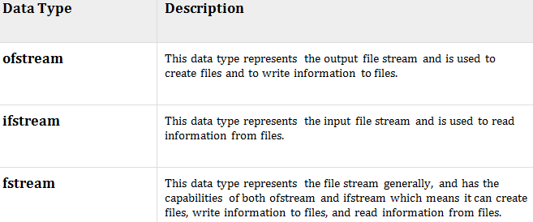
Stream Classes
So far, we have been using the iostream standard library, which provides cin and cout methods for reading from standard input and writing to standard output respectively.
Another standard C++ library called fstream is used to read and write from a file., which defines three new data types:
Notes:
To perform file processing in C++, header files <iostream> and <fstream> must be included in your C++ source file.

Slide 5
Advantages of Streams
C programmers may wonder what advantages there are to using the stream classes for I/O, instead of traditional C functions such as printf() and scanf(), and—for files—fprintf(), fscanf(), and so on.
One reason is simplicity. If you’ve ever used a %d formatting character when you should have used a %f in printf(), you’ll appreciate this. There are no such formatting characters in streams, since each object already knows how to display itself. This removes a major source of errors.
Another reason is that you can overload existing operators and functions, such as the insertion (<<) and extraction (>>) operators, to work with classes that you create. This makes your own classes work in the same way as the built-in types, which again makes programming easier and more error free.

Slide 6
Inserters and Extractors
#include <iostream>
using namespace std;
class Date
{
int month, date, year;
public:
Date(int m, int d, int y)
{
month = m; date = d; year = y;
}
friend ostream &operator<<(ostream &os, Date &dt)
{
os << dt.month << '/' << dt.date << '/' << dt.year;
return os;
}
};
int main() {
Date dt(5, 6, 92);
cout << dt;
return 0;
}
Notes:
Output: 5/6/92

Slide 7
Formatted I/O
Data which is received by the program without any modifications and sent to the output device without any modifications is known as unformatted data.
On the other hand, sometimes we may want to apply some modifications to the actual data that is being received or sent.
For example, we might want to display an integer in hexadecimal format in the output, leave some whitespace when printing a number and adjustments in the decimal point. Such modified data in known as formatted data.

Slide 8
Formatted I/O
As an example for formatted data, if we want to display a decimal number in hexadecimal format, we can use the hex manipulator as shown below:
cout<<hex<<15

Slide 9
Formatted I/O
Formatted I/O works in two ways:
Using manipulator
Using member function of ios class

Slide 10
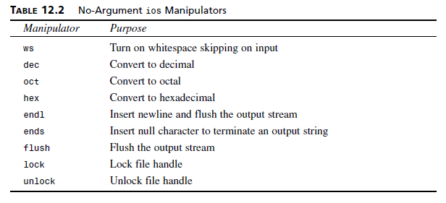
Formatted I/O Using Manipulator
A stream manipulator is a symbol or function that is used by placing it on the right side of the insertion operator << .
A plain manipulator is just a symbol, like a variable: cout << endl; // endl is a stream manipulator.

Slide 11
Formatted I/O Using Manipulator
#include <iostream>
using namespace std;
int main()
{
int num=2017;
cout<<"Number 2017 in Octal = "<<oct<<num<<endl;
cout<<"Number 2017 in Hexadecimal = "<<hex<<num<<endl;
cout<<"Number 2017 in Decimal = "<<dec<<num<<endl;
return 0;
}
Manipulators
Notes:
Output:
Number 2017 in Octal = 3741
Number 2017 in Hexadecimal = 7e1
Number 2017 in Decimal = 2017

Slide 12
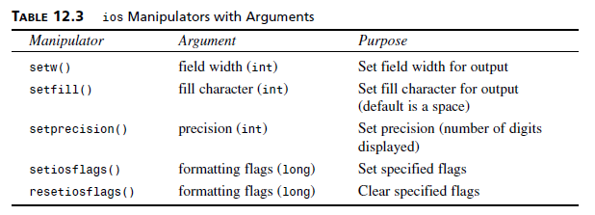
Formatted I/O Using Manipulator

Slide 13
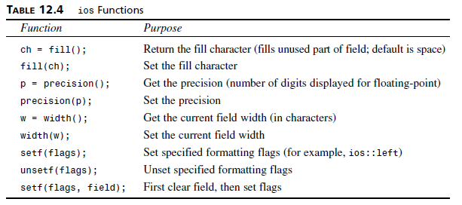
Formatted I/O Using Manipulator
The ios class contains a number of functions that you can use to set the
formatting flags and perform other tasks.

Slide 14
Formatted I/O Using Manipulator
These functions are called for specific stream objects using the normal dot operator. For example, to set the field width to 12, you can say
cout.width(14);
The following statement sets the fill character to an asterisk (as for check printing):
cout.fill(‘*’);
You can use several functions to manipulate the ios formatting flags directly. For example, to set left justification, use
cout.setf(ios::left);
To restore right justification, use
cout.unsetf(ios::left);

Slide 15
Formatted I/O Using Manipulator
A two-argument version of setf() uses the second argument to reset all the flags of a particular type or field. Then the flag specified in the first argument is set.
This makes it easier to reset the relevant flags before setting a new one.
For example
cout.setf(ios::left, ios::adjustfield);
clears all the flags dealing with text justification and then sets the left flag for left-justified output.

Slide 16
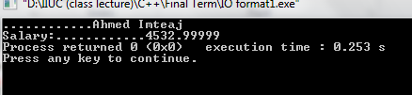
Formatted I/O Using Manipulator
#include<iostream>
using namespace std;
int main()
{
double sal=4532.99999;
cout.fill('.');
cout.width(24);
cout<<"Ahmed Imteaj"<<"\n";
cout.fill('.');
cout.width(19);
cout.setf(ios::left);
cout<<"Salary:";
cout.precision(9);
cout.width(10);
cout.setf(ios::right|ios::showpoint);
cout<<sal;
return 0;
}

Slide 17
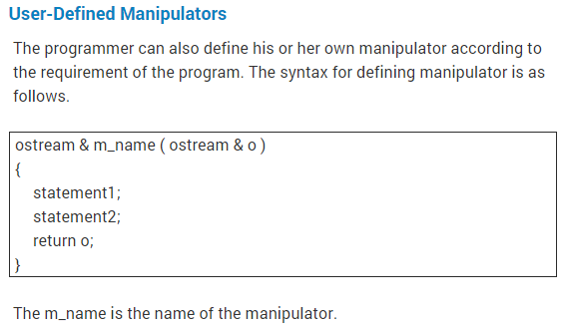
User Defined Manipulators

Slide 18
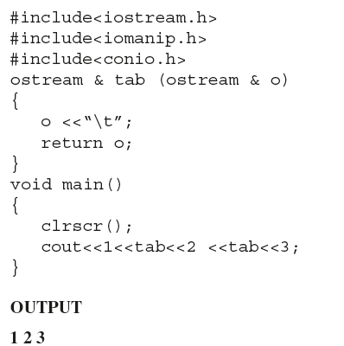
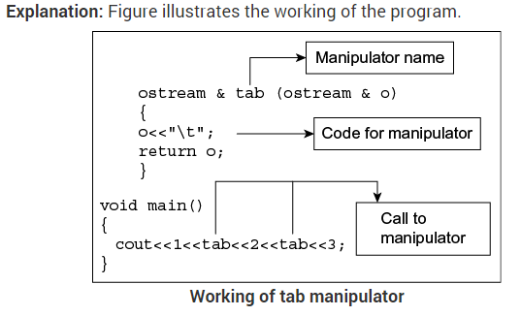
Write a program to create manipulator equivalent to ‘\t’. Use it in the program and format the output.

Slide 19
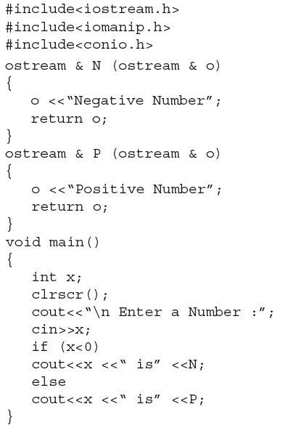
Write a program to display a message using manipulator

Slide 20
Problem
Discuss the syntax to create user-defined manipulators. Design a single manipulator to provide the following output specifications for printing float values:
10 columns width
Right Justified
Two-digit precision
Filling of unused places with *

Slide 21
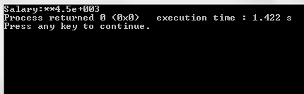
Solution
#include<iostream>
using namespace std;
int main()
{
double sal=4532.99999;
cout<<"Salary:";
cout.width(10);
cout.setf(ios::right);
cout.fill(‘*');
cout.precision(2);
cout<<float(sal);
return 0;
}

Slide 22
Unformatted I/O
The input stream uses cin object of istream class to read data and the output stream uses cout object of ostream class to display data on output devices.
The cin statement uses >> (extraction operator) to read data from keyboard. Syntax of cin statement is shown below:
cin>>variable-name;
Example:
int a;
float f;
char ch;
cin>>a>>f>>ch;

Slide 23
Unformatted I/O
In the above example, cin is used in cascading fashion. This is helpful for reading values into multiple variables in a single statement. No need of any format specifiers like %d, %f etc. The >> (extraction) operator will take care of that automatically.
The cout statement uses << (insertion operator) to display data to the output device. Syntax of cout statement is shown below:
cout<<variable-name;
Example:
cout<<a<<b<<c;
In the above example, a, b, and c are variables. No need to specify format specifiers like %d, %f, etc. The << (insertion) operator will take care of that automatically. All escape sequences like “\n”, “\t”, etc, can be used in cout statement.

Slide 24
Opening and Closing Files
We have to create file when we want to store data in a disk.
All the necessary member functions are declared in fstream.h to use file as i/o stream.
When we want to read data from file we have to create object for ifstream class.
When we want to write data into the file, we have to create object for ofstream class.
We have to create object for fstream class, if we want to read and write data from/to file simultaneously.

Slide 25
Opening and Closing Files
Write a program that creates an output file, write information to it, closes the file and opens again as an input file, and reads the information.
Solution: Next Slide

Slide 26
Opening and Closing Files
cout << "Enter your age: ";
cin >> data;
// again write inputted data into the file.
outfile << data << endl;
// close the opened file.
outfile.close();
// open a file in read mode.
ifstream fin;
fin.open("afile2.dat");
while(!fin.eof())
cout.put(fin.get());
// close the opened file.
fin.close();
return 0;
}
#include <fstream>
#include <iostream>
using namespace std;
int main () {
char data[100];
// open a file in write mode.
ofstream outfile;
outfile.open ("afile2.dat",ios_base::app);
cout << "Writing to the file" << endl;
cout << "Enter your name: ";
cin.getline(data, 100);
// write inputted data into the file.
outfile << data<<endl;
Notes:
Write a program that creates an output file, write information to it, closes the file and opens again as an input file, and reads the information.

Slide 27
References
http://www.tenouk.com/Module18.html

Slide 28
Thank You!!

